Slide 1
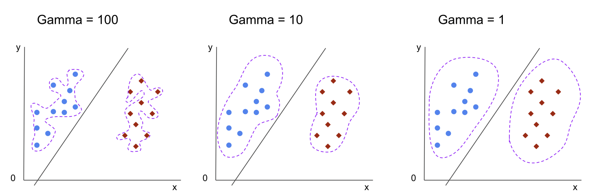
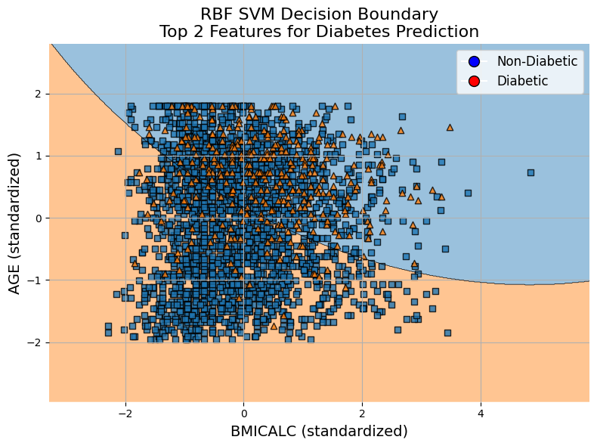
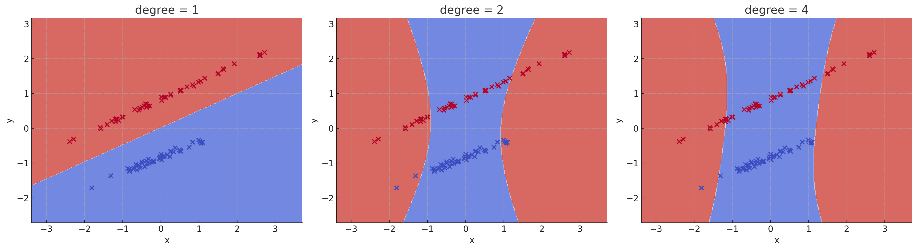
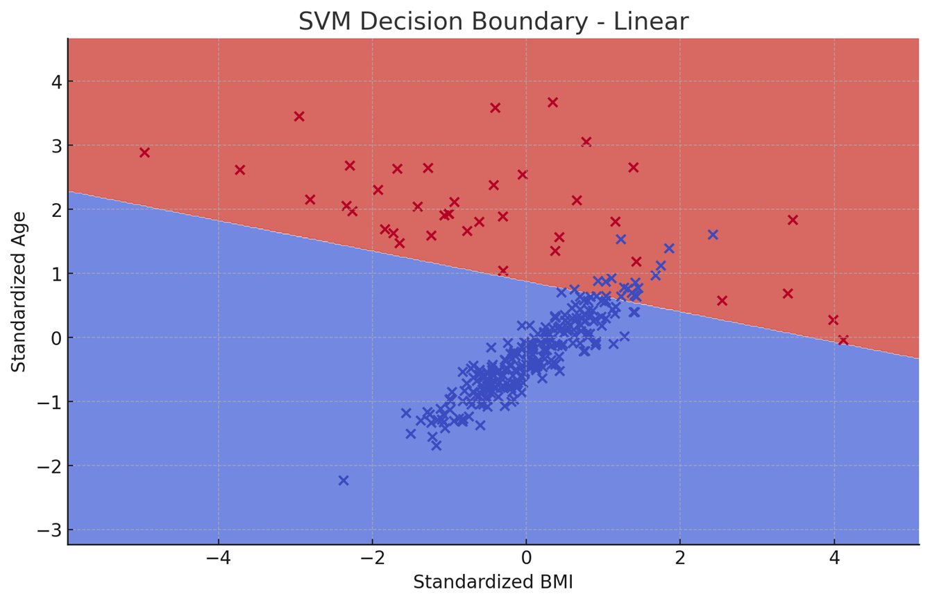
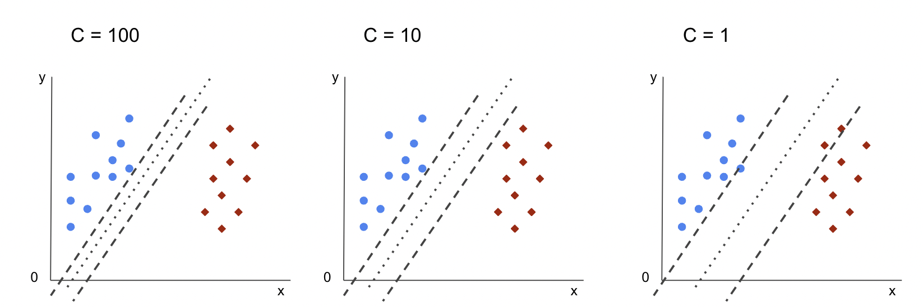
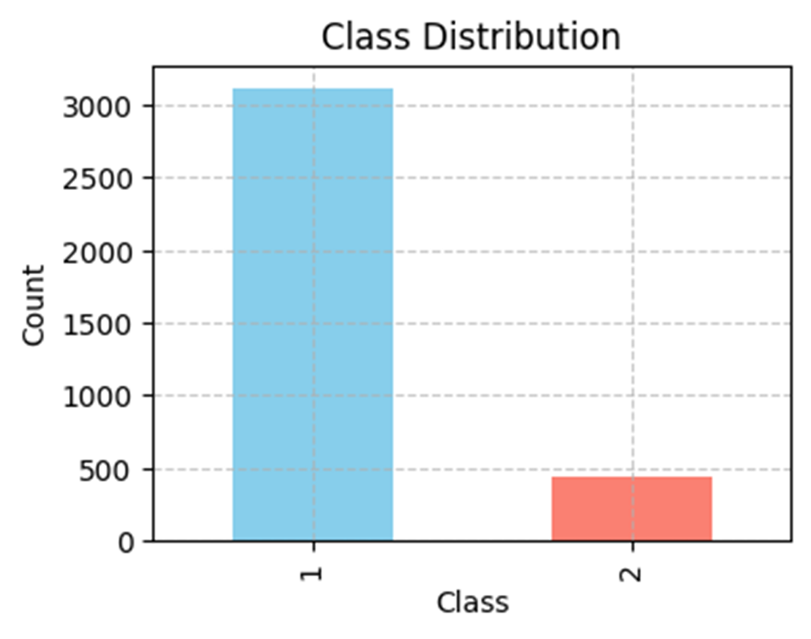
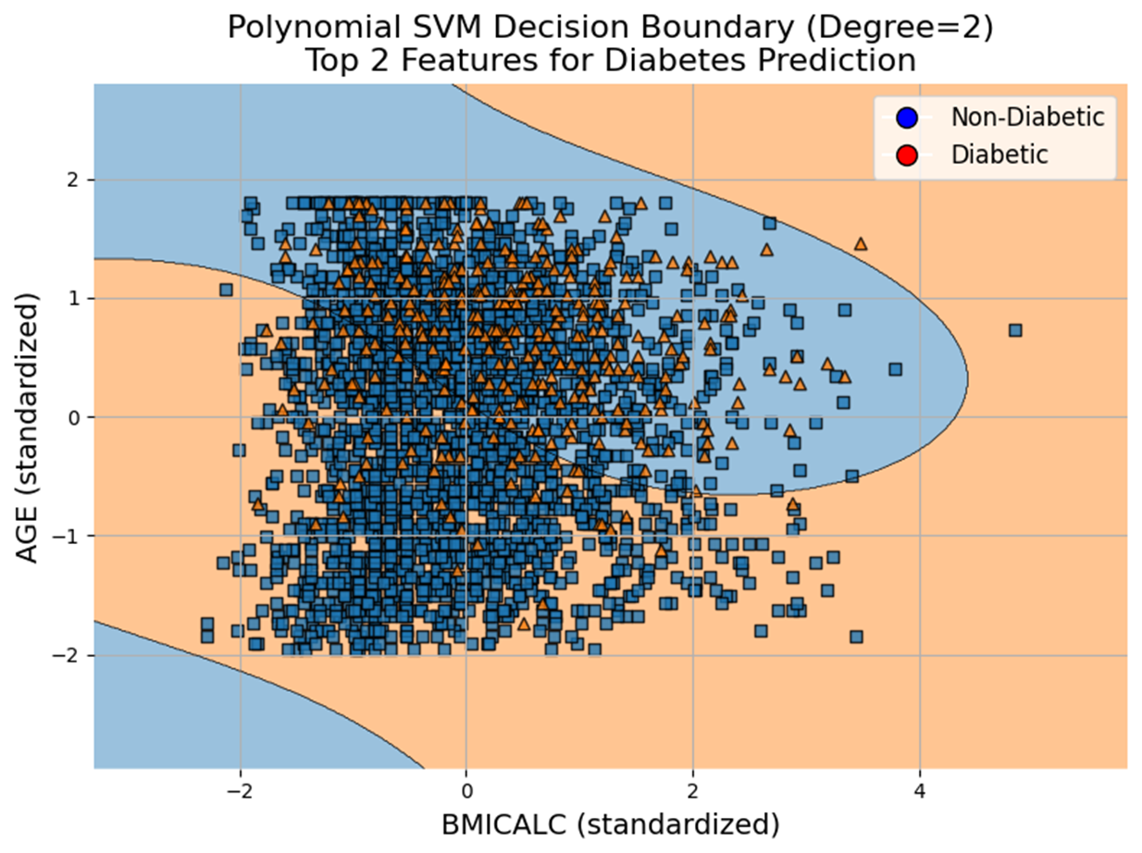
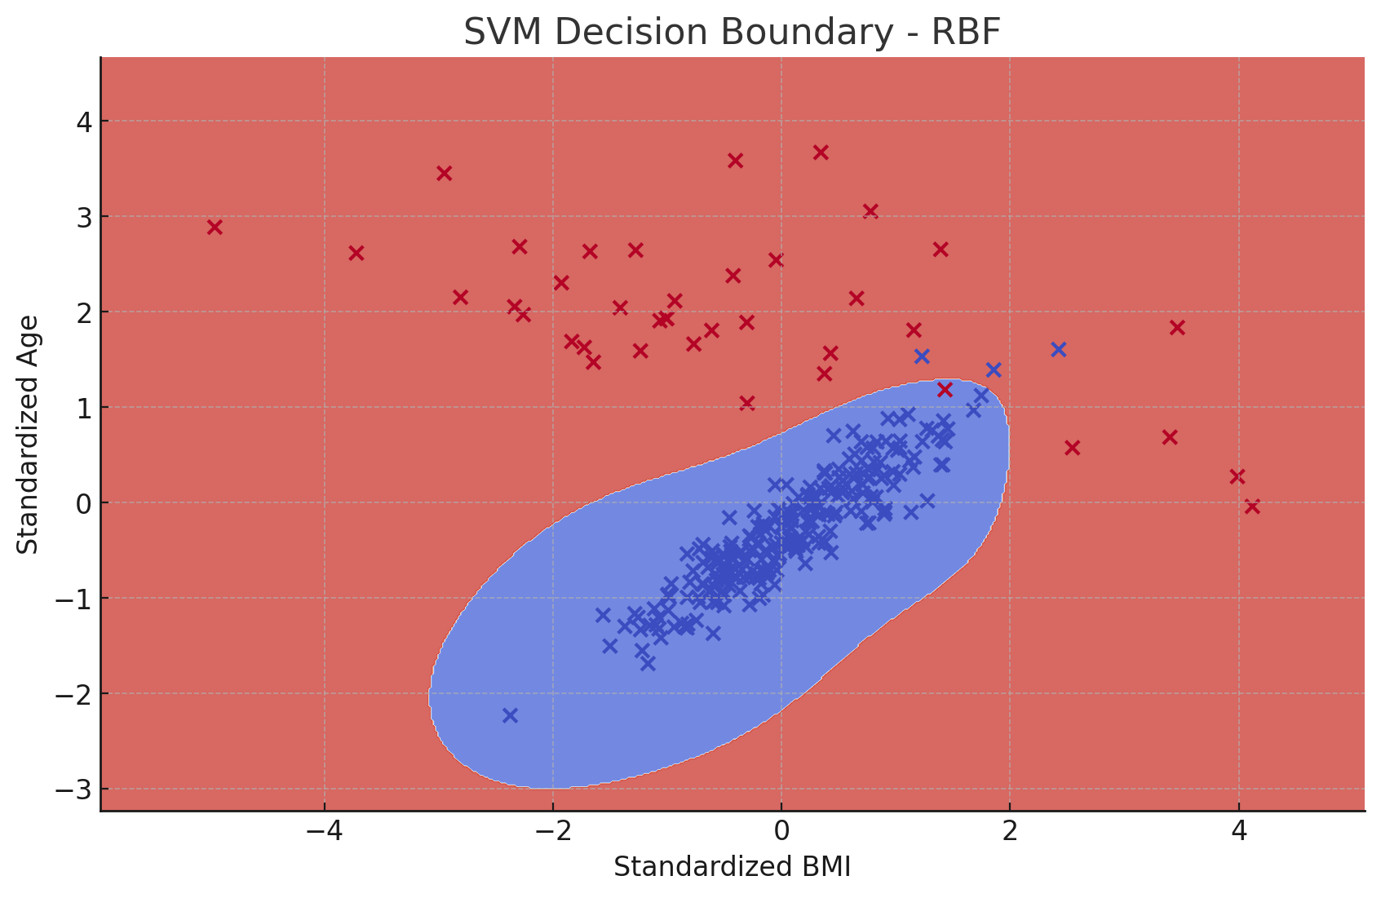
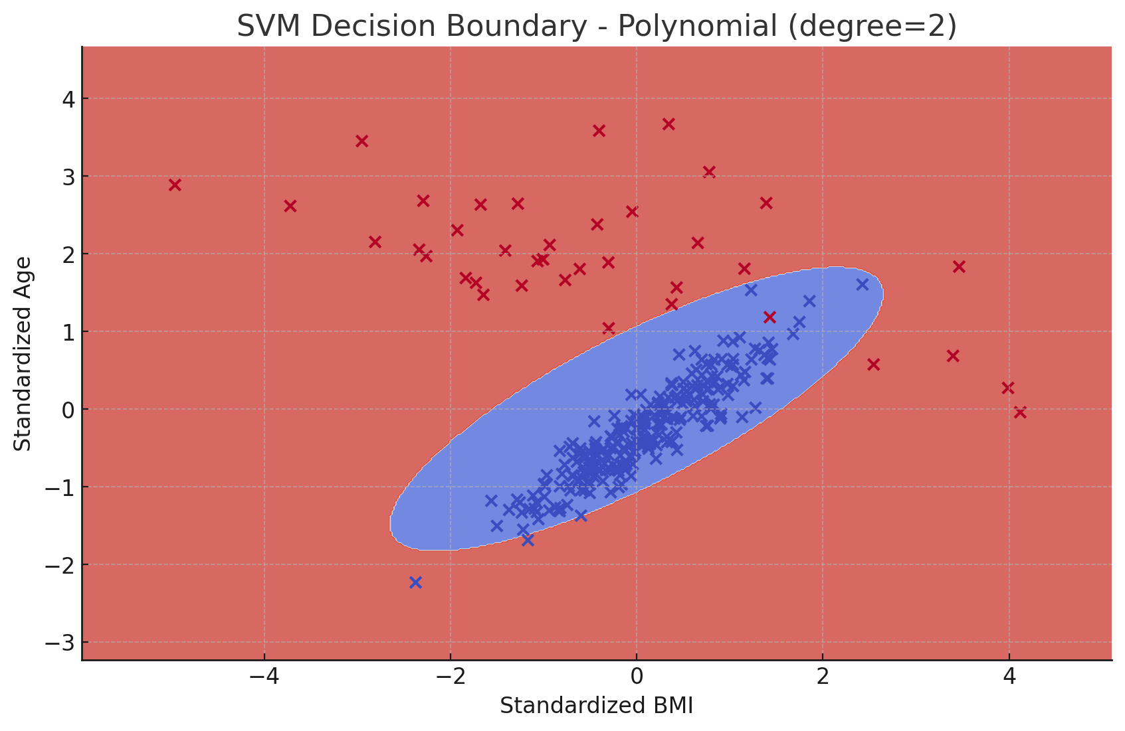
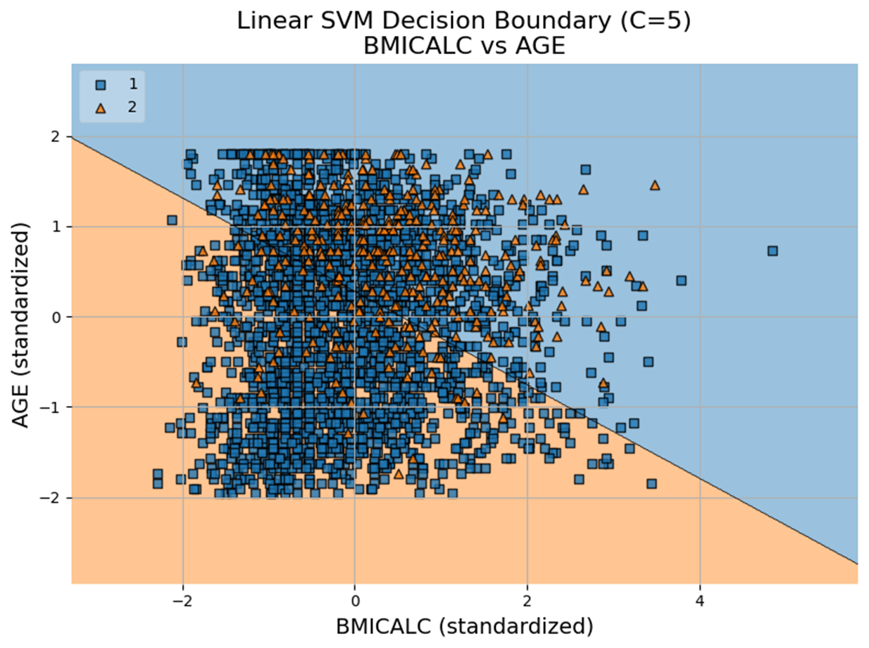
Predicting Diabetes Risk Using Support Vector Machines and Health Behavior Indicators
Fariha Shah (fshah1@seattleu.edu)
Course Code: DATA-3522 - Statistical Machine Learning II
Introduction
SVM Hyper parameters
Results & Plots
2. RBF SVM decision boundary plot captures more complex, nonlinear patterns between BMI, age, and diabetes status. The curved boundary adapts to clusters better than the linear model, but class overlap remains significant while BMI and age carry some predictive power, they may not be sufficient alone to clearly separate diabetic from non-diabetic individuals.
In this practical worksheet we have explored the use of support vector models using 3 model types (Linear, radial, polynomial kernels) for classification using IPUMS Health survey dataset. We have assigned the task is to explore how health behaviors impact health outcomes. The data was collected via the National Health Interview Survey through IPUMS Health Survey. This data set contains variables regarding respondent's demographics, 5 major health conditions such as (cancer, heart disease, diabetes, heart attack and stroke) and their lifestyle and behaviors like work hours, physical activity, sleep habits, and eating habits.
Model Selection: We performed hyper parameter tuning for SVMs using 5-fold cross-validation using (linear, RBF, polynomial) model and estimated the classification report.
Diabetes = Yes (Class 1) | SVM (Linear Kernel) | SVM (RBF) Kernel | SVM (Polynomial) Kernel
Accuracy | 68% | 89% | 66%
Recall | 70% | 0% | 73%
F1-Score | 33% | 0% | 33%
Precision | 22% | 0% | 21%
Gamma: Controls how far the influence of a single training example reaches. The higher its value, the closest are the points that are considered for the decision boundary, and the lowest the gamma, the farther points are also considered for choosing the decision boundary.
Theoretical Background
Support Vector Machines (SVMs in short) are machine learning algorithms that are used for classification and regression purposes.
SVM algorithm is implemented using a kernel It uses a technique called the kernel trick. In simple words, a kernel is just a function that maps the data to a higher dimension where data is separable. In the context of SVMs, there are 4 popular kernels –Linear kernel, Polynomial kernel, Radial Basis Function (RBF) kernel (also called Gaussian kernel) and Sigmoid kernel. These are described below :
Class Imbalance Since RBF did not classify the class “Yes”, as we got precision, recall and f1-score 0. We computed the class imbalance issue in target variable.
3. This Polynomial SVM decision boundary (degree=2) demonstrates a more flexible, curved separation between diabetic and non-diabetic groups using BMI and age. The wavy boundary indicates interactions between the two variables, but it still struggles with overlapping regions. This suggests that while a polynomial kernel captures more complexity than a linear one, additional features may be needed to improve classification.
Degree: Applicable in polynomial kernel, the degree controls the complexity of the boundary. Higher degrees create more complex curves.
Linear: The linear kernel is computationally efficient and works well when the data is linearly separable. It is a good choice for a starting point.
The C parameter is inversely proportional to the margin size, this means that the larger the value of C, the smaller the margin, and, conversely, the smaller the value of C, the larger the margin
Radial Basis Function (RBF) - Default: RBF kernel is versatile and often works well in practice. It is suitable for capturing complex relationships in the data.
Methodology
This imbalance can bias the model toward the majority class, reducing its ability to correctly predict the minority class. Despite using class weights to compensate, the model still struggles to identify diabetic individuals effectively. This explains the relatively lower recall for the "Yes" class.
We performed binary classification using Support Vector Machines (SVMs) to predict diabetes diagnosis (DIABETICEV) based on health behavior and demographic variables from the IPUMS Health Survey. Key predictors included standardized BMI, age, sleep duration, physical activity, and eating habits.
The dataset was filtered to:
Include only male respondents aged 18 or older from the Southern U.S. region
Exclude invalid and top-coded responses (values 996–999)
Remove rows with missing data
Due to class imbalance (~87% “No” vs. 13% “Yes” for diabetes), we applied class_weight='balanced' in all models.
We trained and compared three SVM models via 5-fold GridSearchCV
Linear C = 5 (penalty strength)
Radial Basis Function (RBF) γ = 0.1
Polynomial (degree=3)
Using correlation Matrix the most correlated features were:
Age
BMI
Weight
Model evaluation included accuracy, precision/recall for the minority class, and decision boundary visualizations.
Conclusion
The linear SVM decision boundary kernel separates diabetic and non-diabetic individuals based on standardized BMI and age which suggests that individuals with higher BMI and younger age are more likely to be classified as diabetic. And there is significant class overlap, indicating that BMI and age alone may not provide strong separation for diabetes prediction.
This study applied Support Vector Machines (SVMs) to predict diabetes based on health behavior and demographic data. While RBF and Polynomial kernels captured more complex patterns than Linear SVM, all models were affected by class imbalance and overlapping features. Hyperparameter tuning improved performance, but limitations in using only BMI and age were evident.
Recommendations for Future Work
Address class imbalance using SMOTE or undersampling
Explore ensemble models like XGBoost or Balanced Random Forest
Engineer additional features and apply feature selection
Use metrics like AUC-ROC and precision-recall curves
Apply stratified cross-validation for more reliable evaluation
Polynomial (Poly): The polynomial kernel is effective in capturing non-linear relationships. The degree of the polynomial can be adjusted to control the model complexity.
References
https://www.kaggle.com/code/prashant111/svm-classifier-tutorial/notebook#2.-Support-Vector-Machines-intuition-
https://medium.com/@abhishekjainindore24/svm-kernels-and-its-type-dfc3d5f2dcd8
https://scikit-learn.org/stable/modules/generated/sklearn.model_selection.GridSearchCV.html
https://serokell.io/blog/support-vector-machine-algorithm

